Slide 1
CSC2203 – Visual Basic Workshop
Lecture 1: Introduction
A. A. Datti
1

Slide 2
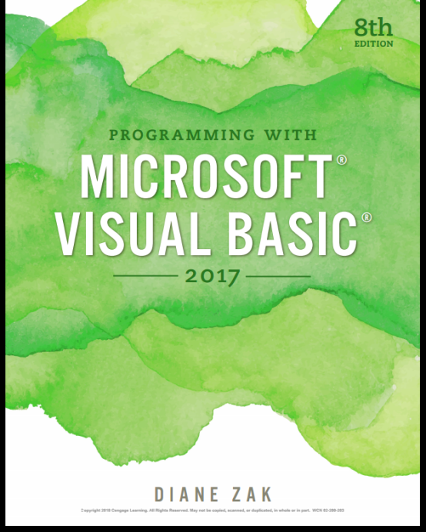
Course Outline
An Introduction to Visual Studio and Visual Basic
Planning Applications and Designing Interfaces
Coding with Variables, Named Constants and Calculations
The Selection Structure
The Repetition Structure
Subroutine and Function Procedures
Arrays
Sequential Access Files and Menus
SQL Server Databases

Slide 3
An Introduction to Visual Studio and Visual Basic
Review of Programming
The Visual Studio IDE
Start Visual Studio
Create a Windows Forms Application
Save a Solution
Close and Open a Solution
Summary

Slide 4
Programmers
Programs
Directions given to a computer to accomplish a given task
Programmers
People who write programs
Programming
The process of giving directions to a computer in order to accomplish a given task

Slide 5
A Brief History of Programming Languages
Machine Languages
0 (for on switch)
1 (for off switch)
Tedious and prone to error
Assembly Languages
More advanced than machine languages
Mnemonics (memory aids)
Examples: MUL b1, ax
Require an assembler
High Level Languages
Require Interpreter or compiler
Interpreter translates high-level into machine code line-by-line while program is running
Compiler translates entire program before program has run
English like syntax

Slide 6
Program’s User Interface
Command Line Interface
A command line interface (CLI) enables users to type (text-based) commands in a terminal or console window to interact with a program. Users respond to a visual prompt by typing a command on a specified line, and receive a response back from the system. Users type a command or series of commands for each task they want to perform.
Graphical User Interfaces
A graphical user interface (GUI) uses graphics, along with a keyboard and a mouse, to provide an easy-to-use interface to a program. A GUI provides windows, pull-down menus, buttons, scrollbars, iconic images, wizards, other icons, and the mouse to enable users to interact with the operating system or application.

Slide 7
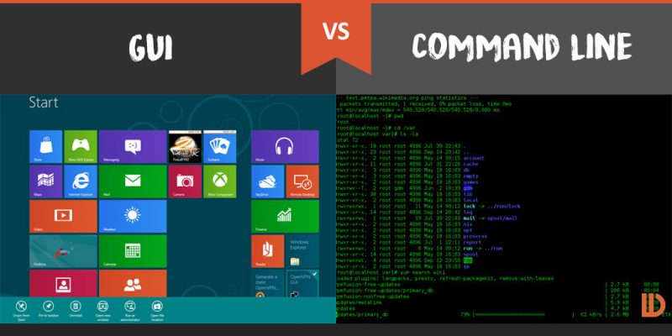
Program’s User Interface

Slide 8
Program’s User Interface
Ease:
If we talk about ease of use, the new users will pick up a GUI much faster than a CLI. In a CLI, new users have some difficulty operating it because they are not familiar with the commands.
Speed:
If we talk about speed, in a GUI, using the mouse and the keyboard to control the file system or the operating system is going to be slower than using the command line.
In a CLI, the users only need to utilize the keyboard and may need to execute only few commands to complete the task.

Slide 9
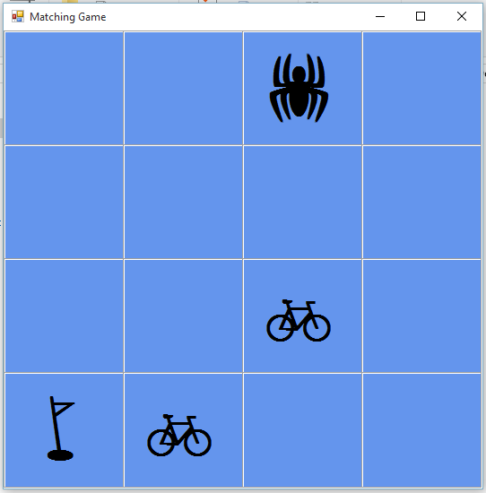
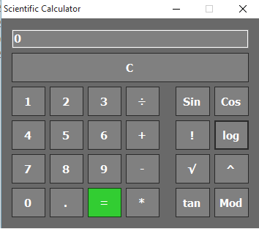
Sample VB Programs

Slide 10
Visual Studio IDE
IDE
Integrated Development Environment
Contains all the features needed to create, run, and test programs
Editor for entering program instructions
Compiler for running and testing program
Allows creation of Web-based and Windows-based applications

Slide 11
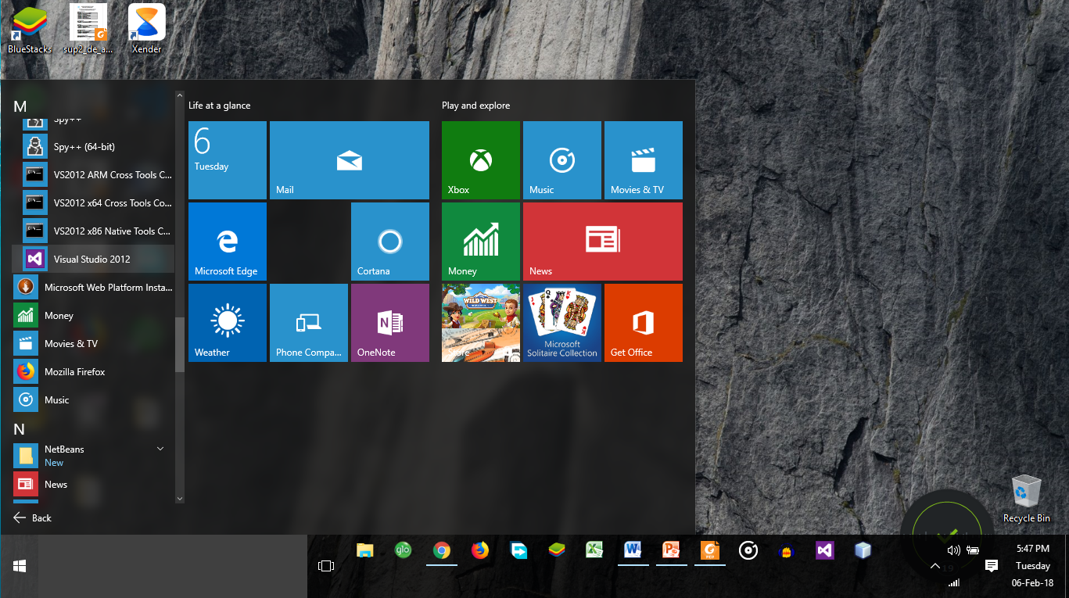
Starting Microsoft Visual Studio
Just Locate the Microsoft Visual Studio Program from the Start Menu of your operating System

Slide 12
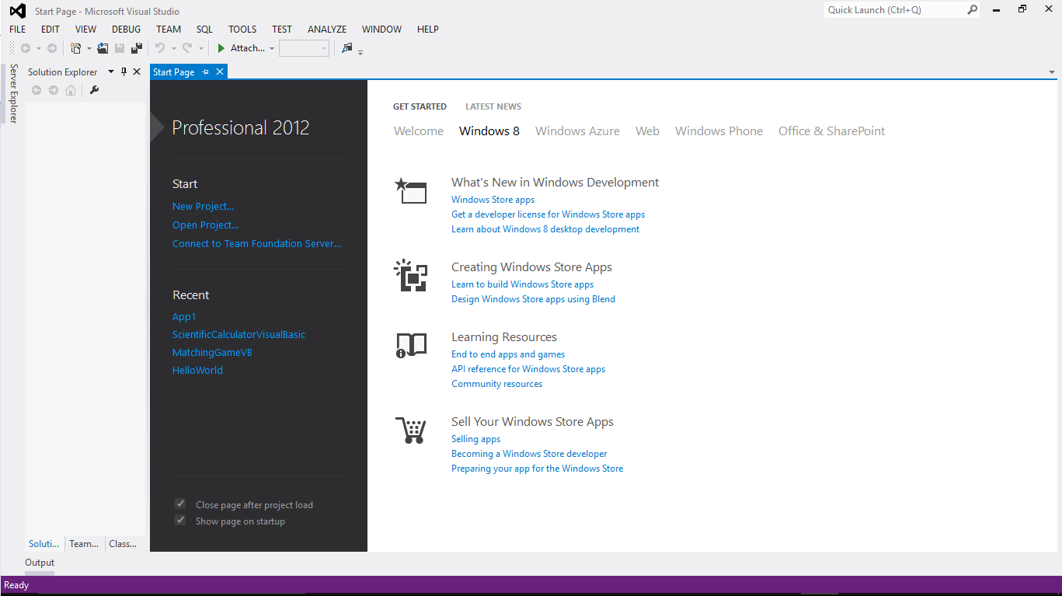
Visual Studio Startup screen

Slide 13
Create a Windows Forms Application
Click File on the menu bar and then click New Project to open the New Project dialog box.
If necessary, click the Visual Basic node in the Installed Templates list, and then click Windows Forms.
Change the name entered in the Name box to the name you want.
Specify the folder
Click the OK button to close the New Project dialog box.
The computer creates a solution and adds a Visual Basic project to the solution. The names of the solution and project, along with other information pertaining to the project, appear in the Solution Explorer window.
Visual Basic also automatically instantiates (creates) a form object, which appears in the designer window.

Slide 14
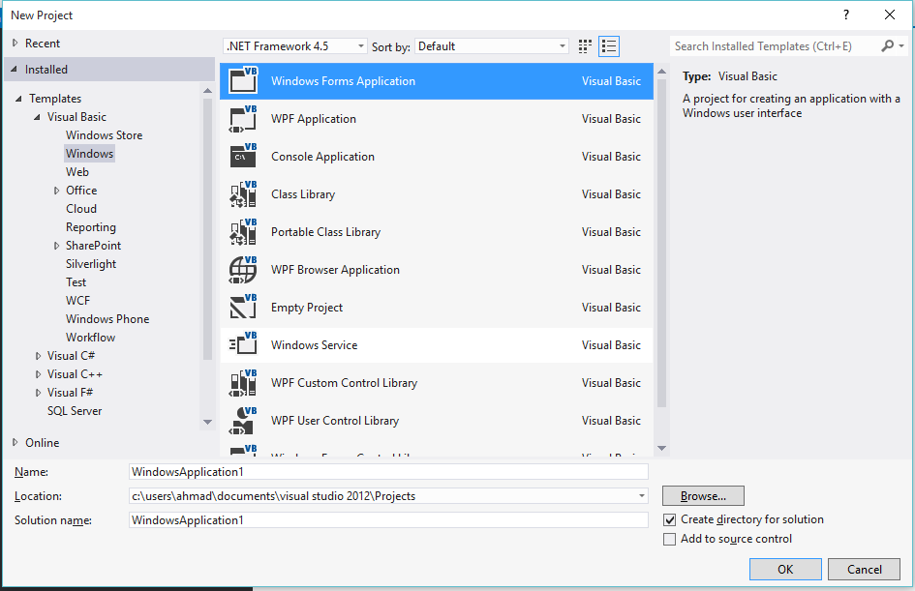
Creating A Visual Basic Windows-Based Application

Slide 15
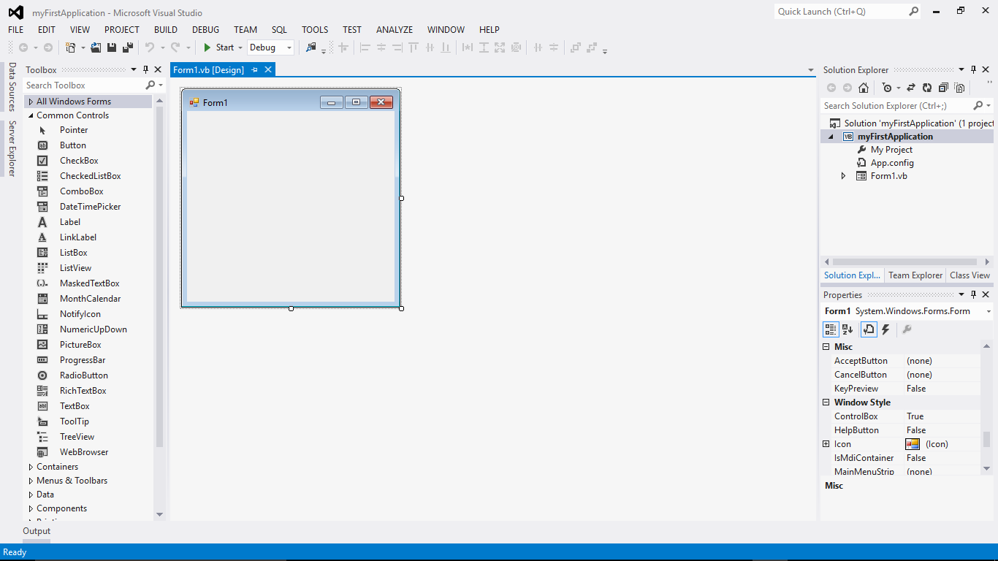
Creating A Visual Basic Windows-Based Application (continued)

Slide 16
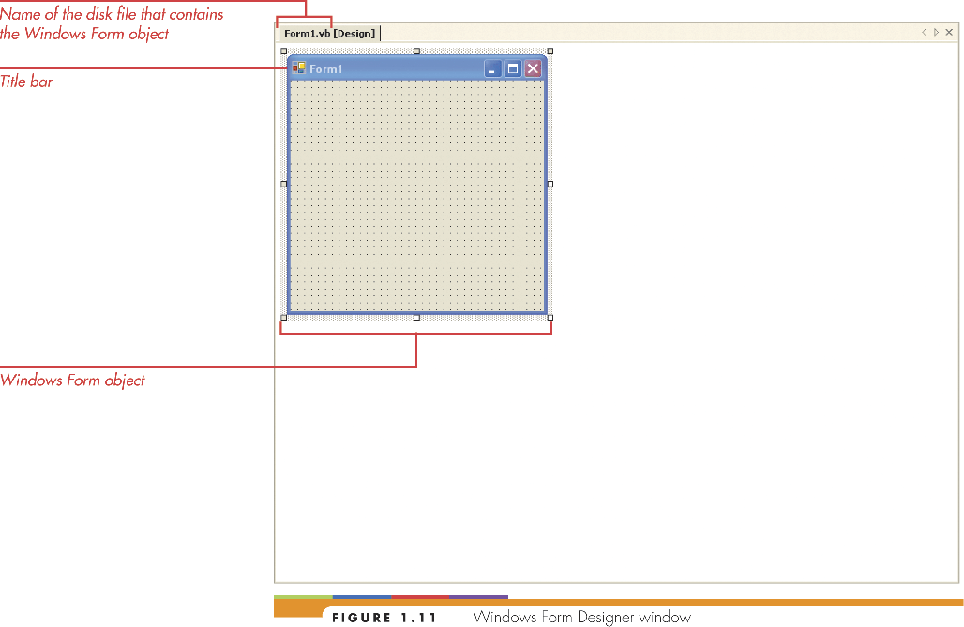
The Windows Form Designer Window
Windows form object (form)
Foundation for the user interface

Slide 17
Solution Explorer Window
Solution .sln
Container for project and files for application
Project .vbproj
Container for storing files associated with a specific piece of the application
Files
Individual files necessary to store information about the application
Include forms and class information

Slide 18
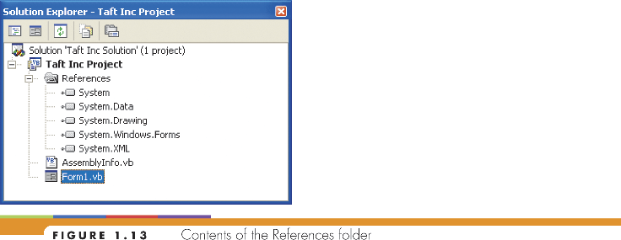
The Solution Explorer Window (continued)

Slide 19
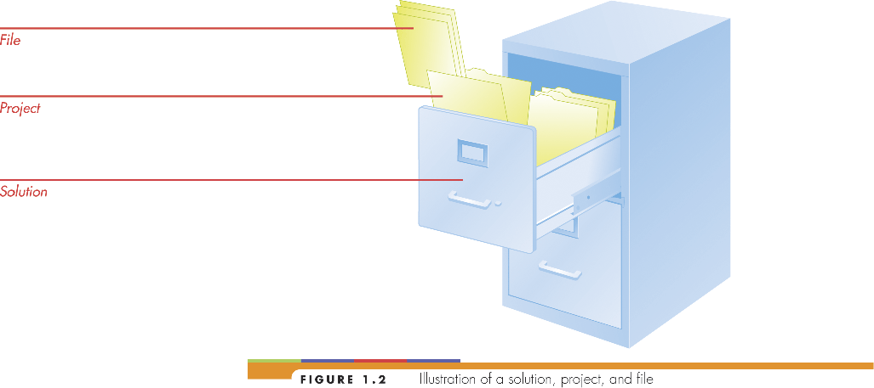
Illustration of solution, project, and file

Slide 20
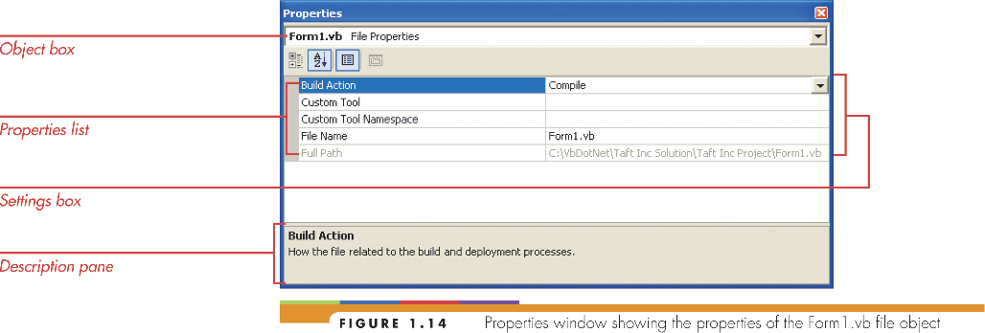
The Properties Window
Object box (contains name of selected object)
Properties list has 2 columns
Left column displays property names
Right column displays Settings box
Contains current value for each property

Slide 21
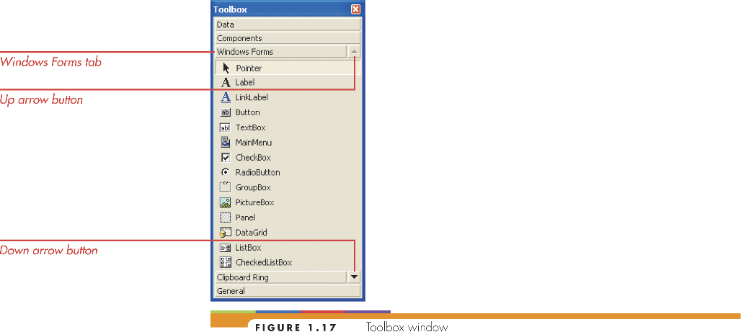
The Toolbox Window
Toolbox contains tools and other components used in creating application
Tools are called controls
Controls are displayed on the form

Slide 22
The Code Editor Window
Events
Actions such as clicking, double-clicking, and scrolling
Event Procedures
Set of Visual Basic instructions (code)
Tells an object how to respond to an event
Contained in the Code Editor Window

Slide 23
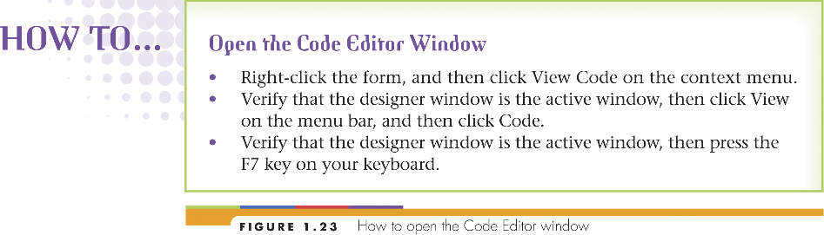
HOW TO…

Slide 24
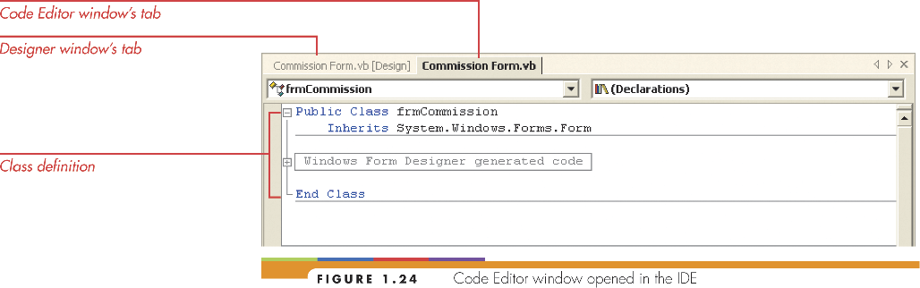
The Code Editor Window (continued)

Slide 25
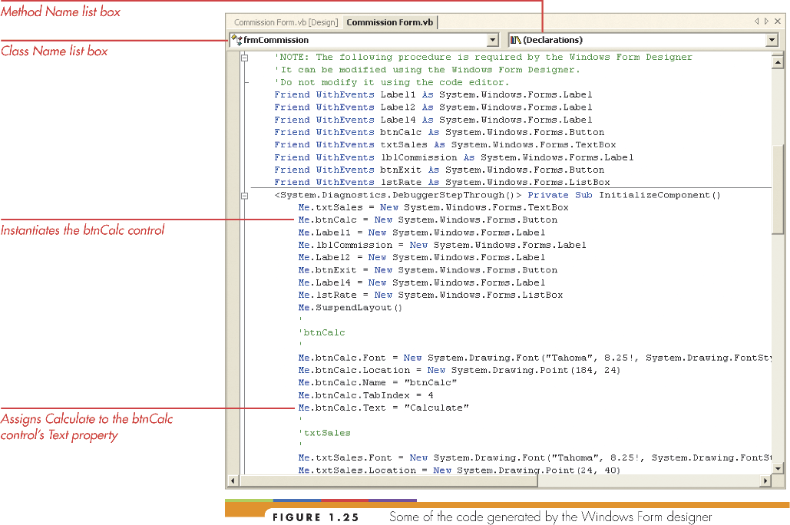
The Code Editor Window (continued)

Slide 26
Code Editor Window (continued)
Class name list box
Lists names of objects on user interface
Method name list box
Lists events selected object responds to
Procedure
Block of code that responds to an event

Slide 27

Saving a Solution

Slide 28
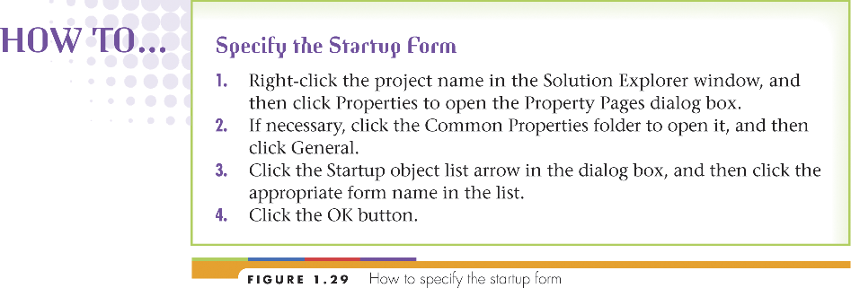
Starting and Ending an Application

Slide 29

HOW TO…

Slide 30
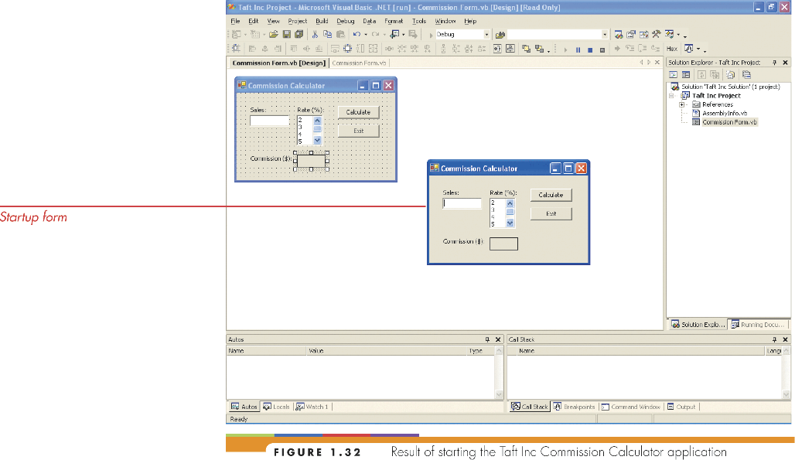
Starting an Application

Slide 31

Closing the Current Solution

Slide 32
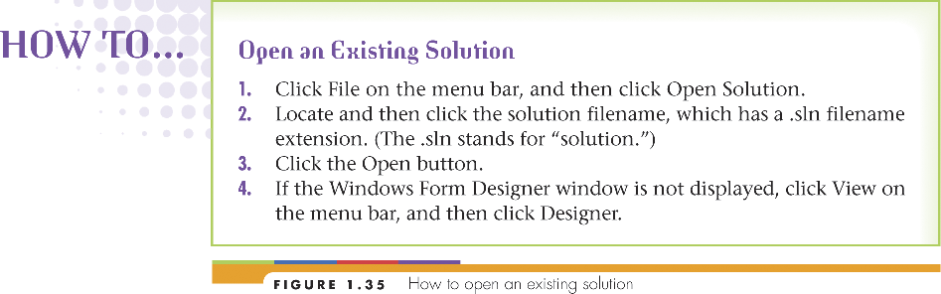
Opening an Existing Solution

Slide 33
Summary
Programming languages have evolved from machine languages to high-level program languages
Object Oriented Programming includes:
Objects – things with attributes and behaviors
Attributes are the characteristics of an object
Behaviors are actions that an object performs
Integrated Development Environment (IDE)
Used to manage windows, set properties, and write code for an application

Slide 34
Summary (continued)
Forms are the user interface of an application
Contain controls such as Buttons and Labels
Have code to perform specific tasks
Code contained in Code Editor Window
Additional Tips:
Saving your Solution → (do often)
Saves all files associated with the application
When starting an application (with more than one form)
You must specify a startup form

